Slide 1
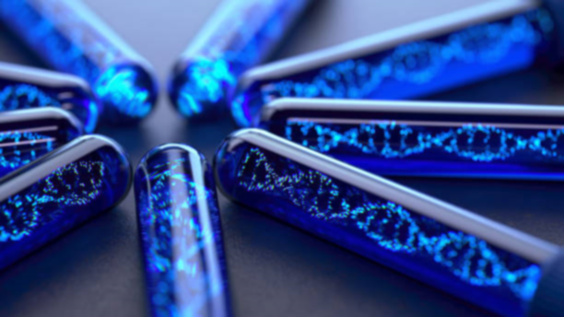
A deep dive into Bio-Nanotechnology
Biology for Engineers
Seminar By Group 4

Slide 2
TABLE OF CONTENTS
01
INTRODUCTION
02
CHANGE IN LAWS
03
APPLICATIONS
04
ENVIRONMENTAL IMPACT
05
ACHIEVEMENTS
06
PERSPECTIVE AND ETHICS

Slide 3
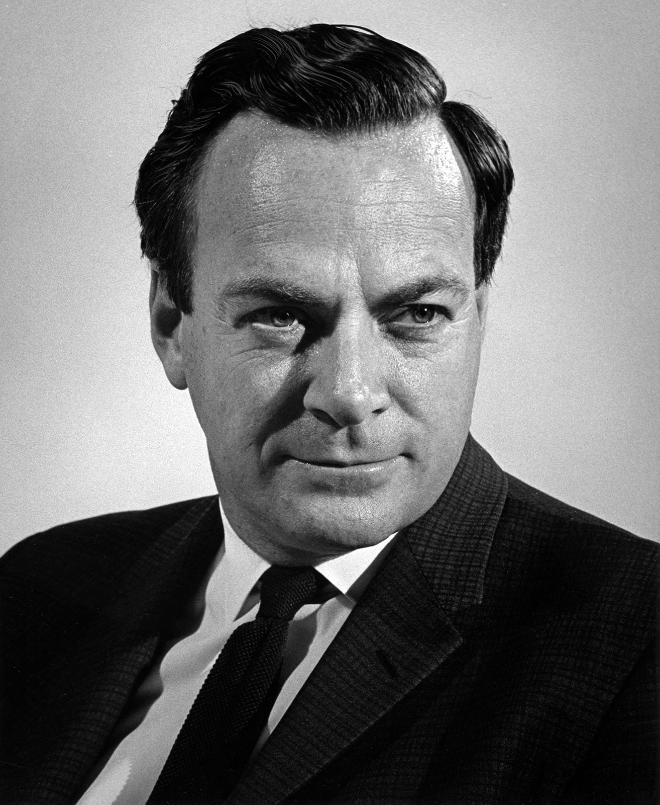
The Beginning of Nanotechnology
The ideas and concepts of nanotechnology were first introduced by physicist Richard Feynman in a lecture in 1959. He speculated the inconceivable possibilities and potentials in the very small world. Arguing that there is an abundant number of atoms building up the ordinary matter, he expected that there is plenty of space within the matter.

Slide 4
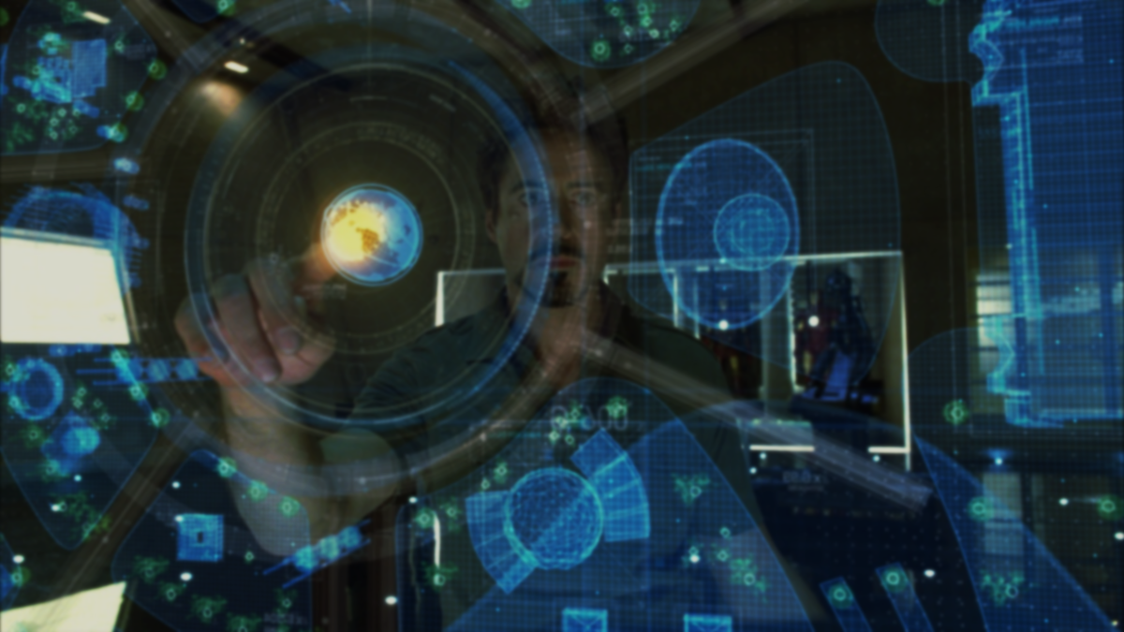

The Definition of Nanotechnology
Nanotechnology is usually defined as the manipulation of materials that range from the nanometer (nm) to the micrometer (um) scale. For comparison, the cells of living organisms are typically around 10 um across. That puts the machinery and components of living cells within the nanoscale size range, making them ideal for interactions with functional nanoparticles and nanomachines.

Slide 5
Defining Biotechnology
Biotechnology can also be termed as, “the application of scientific and engineering principles to the processing of materials by biological agents.” Biotechnology is the integration of biochemistry, microbiology, and engineering disciplines to promote industrial applications of microorganisms, engineered cells, tissues, and so on.

Slide 6
A new Field with developing Scope
Biotechnology, nanotechnology and bionanotechnology are virtually novel concepts. Up to now, there is no consensus on the definition and scopes of these fields. To some extent, many new nanotechnological discoveries cross existing conceptual border of biotechnology and vice versa.

Slide 7
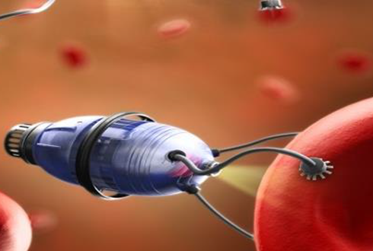
The Birth of Bionanotechnology
We are now poised to extend biotechnology into bionanotechnology.
Bionanotechnology is a science that sits at the convergence of nanotechnology and biology. Nanobiology and nanobiotechnology are other names that are used interchangeably with bionanotechnology. The field applies the tools of nanotechnology to biological problems, creating specialized applications.

Slide 8
From Biotech to Bionanotech
bionanotechnology includes the applications that require human design and construction at the nanoscale level. Biotechnology grew from the use of natural enzymes to manipulate the genetic code, which was then used to modify entire organisms.
The atomic details were not really important—existing functionalities were combined to achieve the end goal. Today, we have the ability to work at a much finer level with a more detailed level of understanding and control

Slide 9
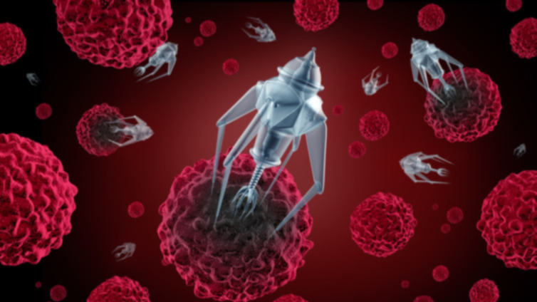
The Atom is now the Limit
We have the tools to create biological machines atom-by-atom according to our own plans. Now, we must flex our imagination and venture into the unknown.
Bionanotechnology has many different faces, but all share a central concept: the ability to design molecular machinery to atomic specifications. Today, individual bionanomachines are being designed and created to perform specific nanoscale tasks, such as the targeting of a cancer cell or the solution of a simple computational task.

Slide 10
The Timeline of Significant Human Achievements into Nanobiotech
1953
1975
1996
2011
Watson and Crick’s Double Helix model of DNA helped to explain deoxyribonucleic acid (DNA) replication and its role in inheritance
Kohler and Milstein postulated the concept of cytoplasmic hybridization and produced the First monoclonal antibodies
Irish scientist Ian Wilmut was successful to clone an adult sheep and developed the first ever cloned animal name Dolly
There is possibility to sequence the Human genome.

Slide 11
Effect of Laws of Science

Slide 12
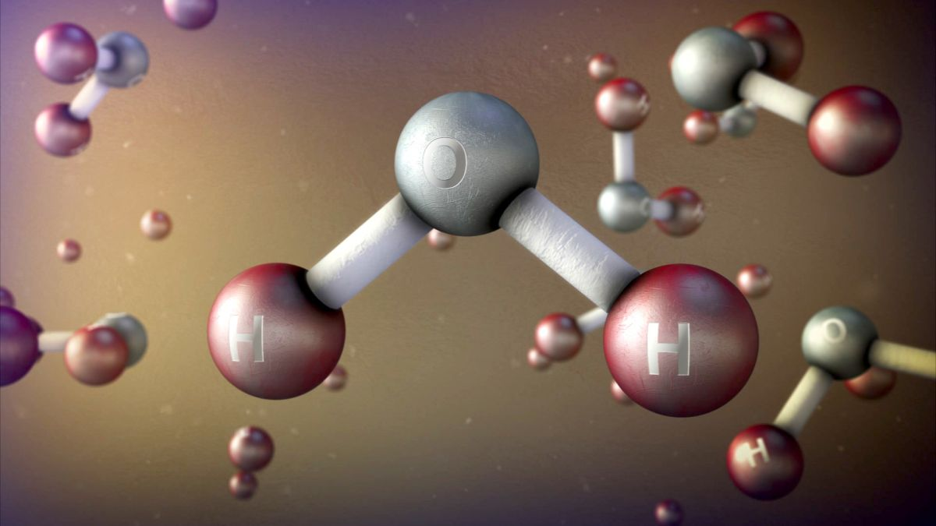
How The Laws of Science are Different at the Nano Scale
The laws of physics operate in unfamiliar ways on these length scales, and this is important to appreciate for two reasons. The peculiarities in behaviour imposed by the nanoscale impose strong constraints on what is possible to design and make on this scale.
But the very different behavior of matter on the nanoscale also offers opportunities for structures and devices that operate on radically different principles from those that underlie the operation of familiar macroscopic objects and devices.

Slide 13
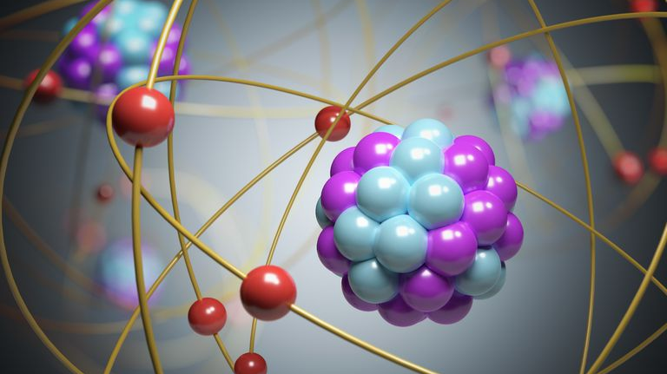
Their Unique Properties
Nanoscale materials have unusual properties distinct from bulk materials. Some of these enhanced properties include surface area, cation exchange capacity, ion adsorption, and complexation.
A high proportion of the atoms in a nanoparticle are present on its surface, meaning that compared to macro-scale materials, nanoparticles have different surface compositions, different reactivity, and different types of surface interaction sites.

Slide 14
BIONANOTECHNOLOGY IN MEDICINE

Slide 15
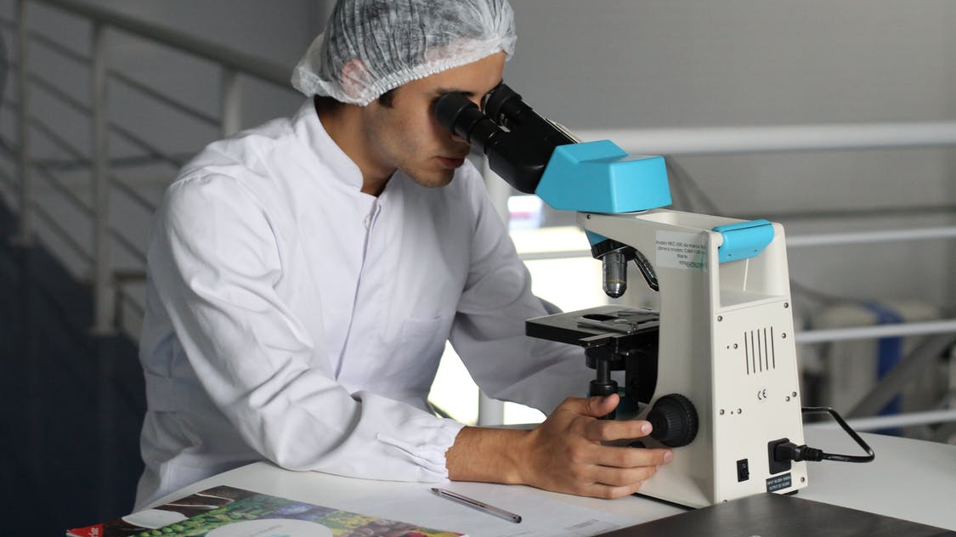
Bionanotechnology in Medicine
The field of biotechnology is focused on basic research into the mechanisms of disease toward the development of new therapeutic and diagnostic devices.
Bionanotechnology applications within biotechnology include the development of microfluidic devices for high throughput drug discovery assays, nanotechnology-based drug delivery devices, genome sequencing, proteomics, and imaging.

Slide 16
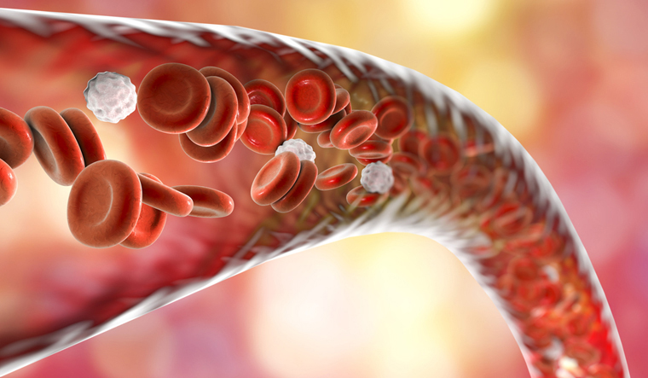
Examples
One example is the use of nanoparticles for drug delivery. A therapeutic is chemically attached to the nanoparticle. Radio or magnetic signals are then used to guide it to its target in the body. Precisely targeted drug delivery enhances efficacy and side effects due to off-target activity.
Gene delivery is another area of active research in bionanotechnology. Nanoparticle-based non-viral vectors of about 50 to 500 nm have been studied for delivery of plasmid-based DNA for gene therapy

Slide 17
Bionanotechnology and DNA

Slide 18
Bionanotechnology and DNA
Nanotechnology based on DNA aims to develop user-defined objects in nanometer scales with high structural and functional complexities with the information encoded in DNA sequences. The most widely used approach for DNA nanotechnology fabrication involves connection of customized multiple double-helical DNA domains using strand backbone linkages.

Slide 19
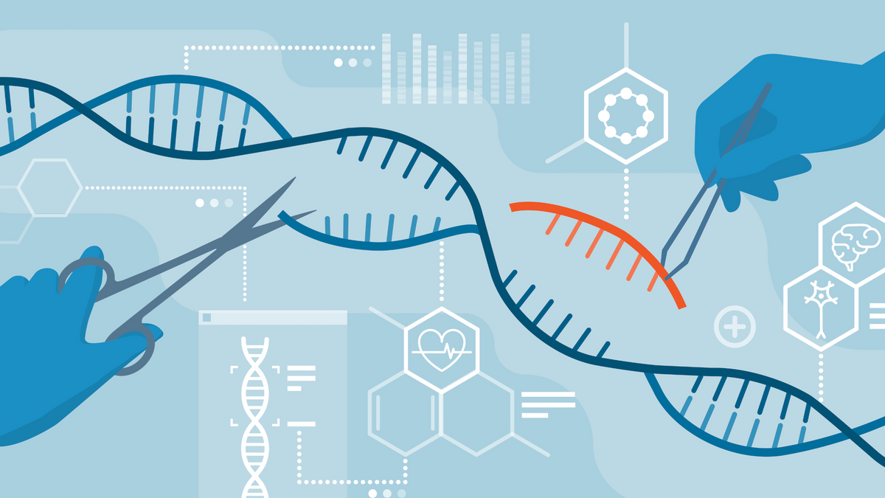
Examples
Genome editing (also called gene editing) is a group of technologies that give scientists the ability to change an organism's DNA. These technologies allow genetic material to be added, removed, or altered at particular locations in the genome. Several approaches to genome editing have been developed.
Gene cloning and vector construction are widely applied techniques in DNA and protein research and molecular biology. Gene cloning is defined as the process of isolating gene or DNA of interest using restriction enzyme or PCR method, ligating the isolated gene into suitable vector and production of enough copies of exact vectors.

Slide 20
CRISPR
A recent one is known as CRISPR-Cas9, which is short for clustered regularly interspaced short palindromic repeats and CRISPR-associated protein 9. The CRISPR-Cas9 system has generated a lot of excitement in the scientific community because it is faster, cheaper, more accurate, and more efficient than other existing genome editing methods.

Slide 21
CRISPR-Cas9 was adapted from a naturally occurring genome editing system in bacteria. The bacteria capture snippets of DNA from invading viruses and use them to create DNA segments known as CRISPR arrays. The CRISPR arrays allow the bacteria to "remember" the viruses (or closely related ones). If the viruses attack again, the bacteria produce RNA segments from the CRISPR arrays to target the viruses' DNA. The bacteria then use Cas9 or a similar enzyme to cut the DNA apart, which disables the virus.

Slide 22
Bionanotechnology in Robotics Bionanorobotics

Slide 23

Bionanotechnology in Robotics bionanorobotics
Nanorobotics is a very new potential area of nanotechnology that is basically identified the Type of nanotechnology engineering of designing, building and fabricating machines, And devices or robots reached the scale of nanometers
Nanorobots thereby have the abilities to interact and impact to matter, And perform the selected functions at the nano scale. Some of nanorobot abilities That are needed for functioning may include automatic intelligence handling, self Assembly and replication, information processing and programmability at the nano Scale and nano-interface structure.

Slide 24
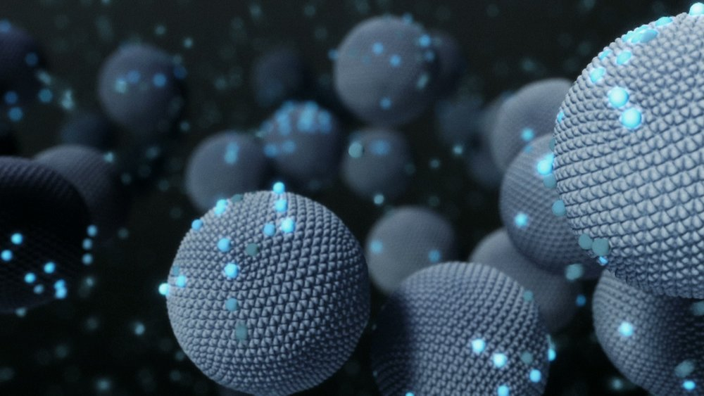
Principles
When designing or approaching a bionanorobotic device, biomimetics is needed to be noted. There are two principles one can take in biomimetics, when is comes to nanorobotics.
The two principles are the device nanomimetics and the bionanomimetics where nanomachine components are fabricated with the homologous equivalent macro-scale components and the construction of the nanomachine components.

Slide 25
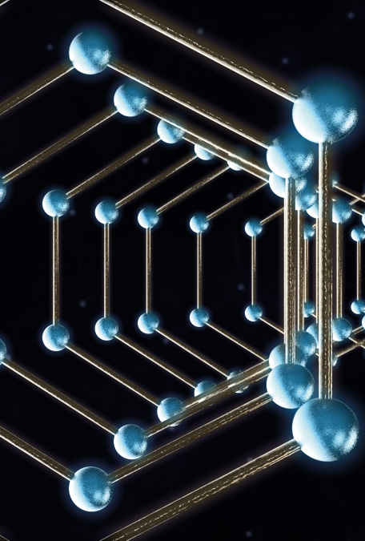
Applications
with some biological substances such as proteins and DNA to form a machines mimicking a biological entity . A bionanorobotics could cover these two mimetic principles. Both principles could be use to fabricate a bionanorobot with bionanomimetic, where is a bottom up process while machine nanomimetic is a top down process.
The micro actuators are motors such as electric and pneumaticmotors, and the equivalent components in the bionanorobots are ATPases and viral protein motors. A bionanomimetic device could be designed up to the microscale or macroscale and vice versa. The researches in this field have mainly focused on nano-components such as biomolecular motors and sensors

Slide 26
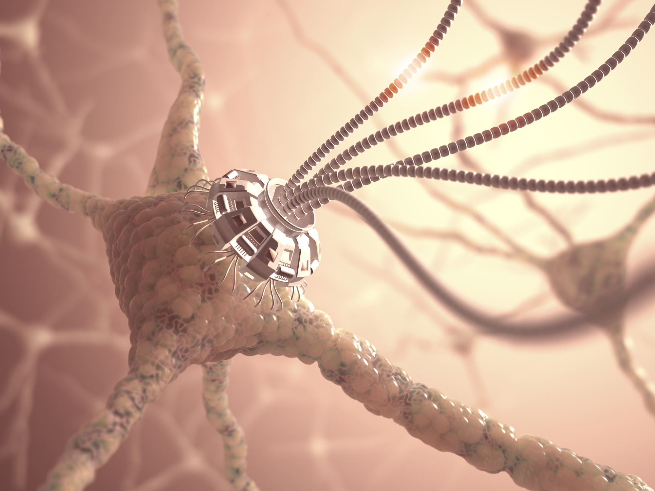
DNA-Based Molecular Nanomachines
DNA, along with its well-comprehended properties, structure as well as predictable Self-assembling, has been studied extensively by researchers and has become a Promising field not only in nanoscale researches but also engineered nanostructures.
We have built artificial DNA-based structures based on these properties in the Form of a cube, knots or polyhedras.
In recent years, DNA has been utilized In mechanochemical as well as nanoelectronic systems. DNA strands were Also mathematically analyzed and treated as an elastic rod. The Manipulations and observations on DNA using mechanical, electronic, and chemical tools have been explored.

Slide 27
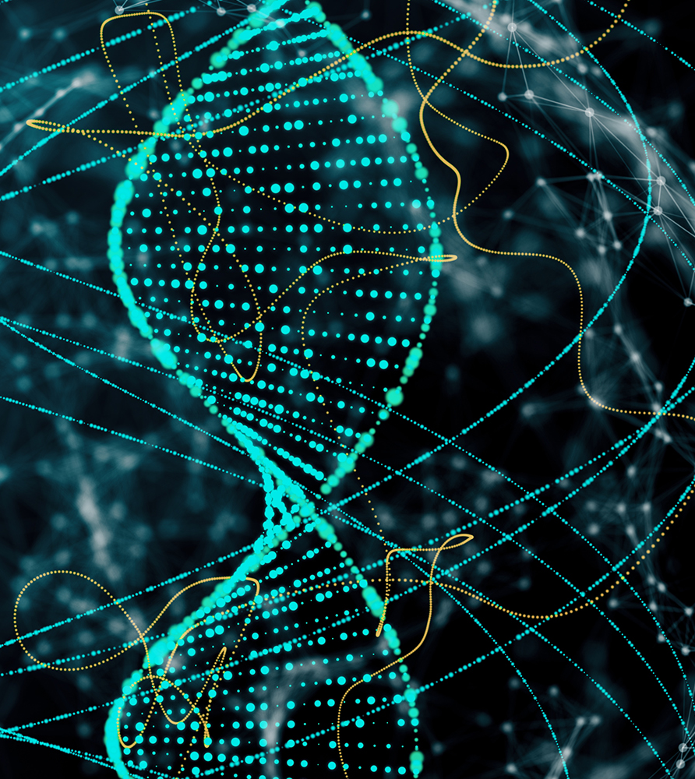
Dr. Mao proposed a DNA device capable of Performing atomic transitions at 2-6 nm, in which the B and Z morphs of the DNA Are chemically transitioning, like a moving nanodevice. Four stranded topoisomeric DNA motifs reversibly transits between each other, thereby rotary motion is Appeared.
Dr. Yurke successfully fabricated a DNA-based molecular Machine, called DNA tweezers which was fueled by adding DNA fuel strands. These devices include three strands A, B, and C of DNA in which the strands A at The middle has a section hybridized with both B and C, and both ends have Knobs

Slide 28
Control Architecture for the Bio-Nanorobotic Systems

Slide 29
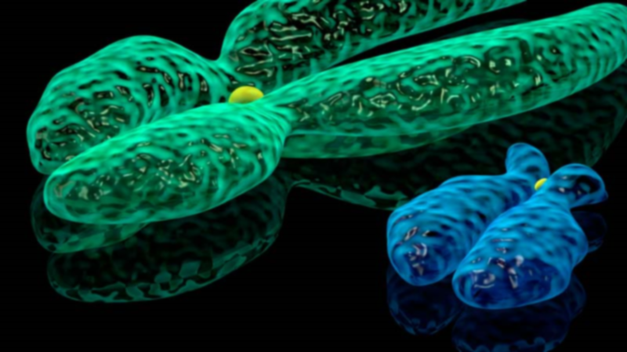
Internal Control Mechanism: Internal control mechanisms, which can be achieved through the control of a internal molecular computer, are based on selective biochemical sensing and binding.
In the field of medic, for example, these internal molecular computers also have a hardware molecular component that are enzymes and software from DNAs. The computer’s input and output modules work in parallel to diagnose and respond to the need for a suitable drug. Adleman and colleagues have introduced a molecular computer made up of DNA molecules.
Shapiro and his colleagues have also programmed molecular computers to handle biological information that used to detect and treat cancer.

Slide 30
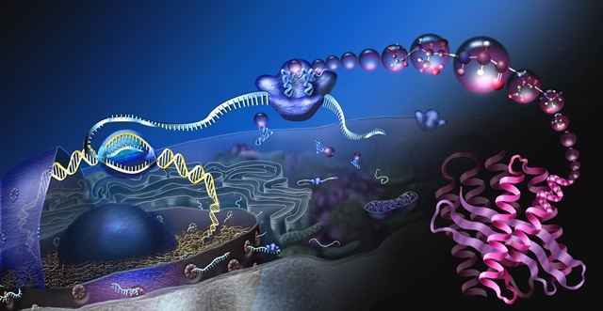
2. External Control Mechanism: By applying external fields, researchers manipulate and control bio-nano robotic systems by influencing their dynamics, such as magnetic resonance imaging (MRI)system utilizing for directing nano particles.
Martel and his colleagues used an MRI system, integrated with a ferromagnetic core with a variable magnetic gradient that was embebed in the bio-nano robotic system, thereby exerting a force on the bionanorobotic system to control motion and its direction
Another mechanism could be a hybrid control of internal-external, therein, the target is fixed by the “external navigator” and the active internal control mechanism defines the manipulation of the bio-nano robotic system.

Slide 31
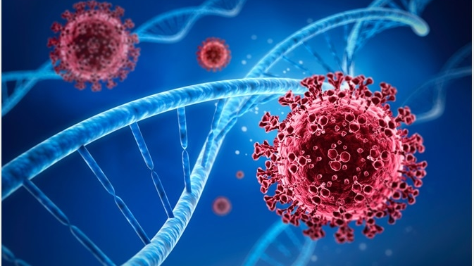
The bio-nano robotic system is on the stage of evolving, so researchers have a lot to do to achieve greater success in the future. The manipulation and impact of not only the operation but also the dynamics and character of the object at the molecular scale, is one of the challenges. The developments in nanotechnology and molecular biology have made the bio-nano robotic system more noticeable.
This system uses different biological components with functions such as sensing, motivating, and processing information or manipulating to make up the bio-nano rorbotic system with various functions, corresponding to certain task requirements.
DNA and protein could play a role of a motor, sensor, coupler, or even a transmission function. Problems such as determining the structure, behavior, and behavior of components, as well as constraints such as the precise mechanism of the ATPase molecular motor, protein folding, etc. should be focused on investigating and processing before starting assemble and building a complex system.

Slide 32
Applications of Bionanotechnology in Cosmetics, agriculture and Environmental Change

Slide 33
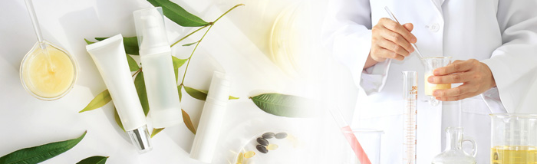
Bionanotechnology in Cosmeceuticals
Nanotechnology incorporation in cosmetic formulation is considered as the hottest emerging nanotechnology available. Cosmetic manufacturers use nanoscale size ingredients to provide better UV protection, deeper skin penetration, long-lasting effects, increased color, finish quality, and many more.

Slide 34
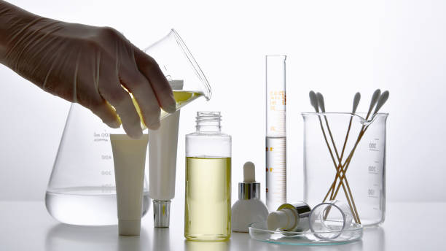
Applications
Micellar nanoparticles is one of the latest field applied in cosmetic products that becoming trending and widely commercialized in local and international markets. The ability of nano-emulsion system to form small micellar nanoparticles size with high surface area allowing to effectiveness of bioactive component transport onto the skin.
Oil in water nano-emulsion is playing a major role as effective formulation in cosmetics such as make-up remover, facial cleanser, anti-aging lotion, sun-screens, and other water-based cosmetic formulations.

Slide 35
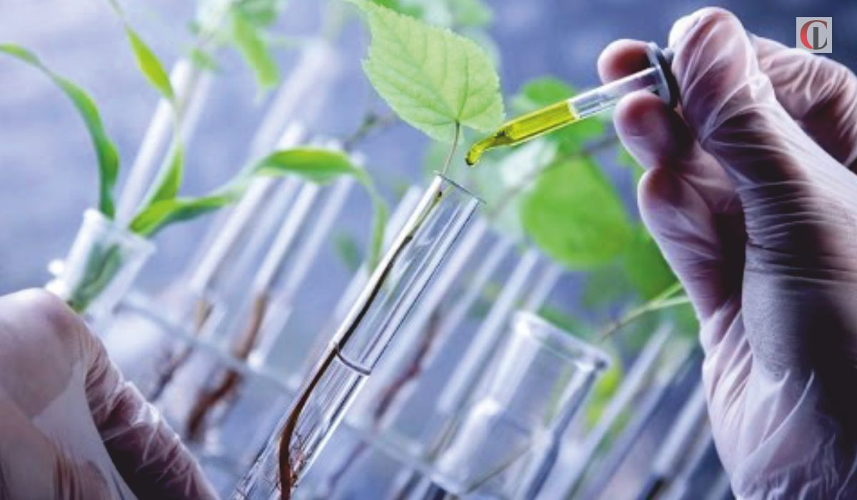
Agricultural Impact of Bionanotechology

Slide 36
Agricultural Impact of Bionanotechology
Nanobiotechnology in agriculture is a driver for modern-day smart, efficient agricultural practices. Nanoparticles have been shown to stimulate plant growth and disease resistance.
The goal of sustainable farming can be accomplished by developing and sustainably exploiting the fruits of nanobiotechnology to balance the advantages nanotechnology provides in tackling environmental challenges.

Slide 37
Biotechnology has caused a revolution in agricultural science. Cell culture and protoplast fusion techniques have resulted in hybrid/cybrid plants through inter-generic crosses which generally are not possible through the conventional hybridization techniques.
It has also helped in the production of encapsulated seeds, somaclonal variants, disease resistant plants, herbicide-and stress-resistant plants, and m/gene and nod gene transfer as well.
Through cell culture techniques, industrial production of essential oils, alkaloids, pigments, etc. have been boosted up.

Slide 38
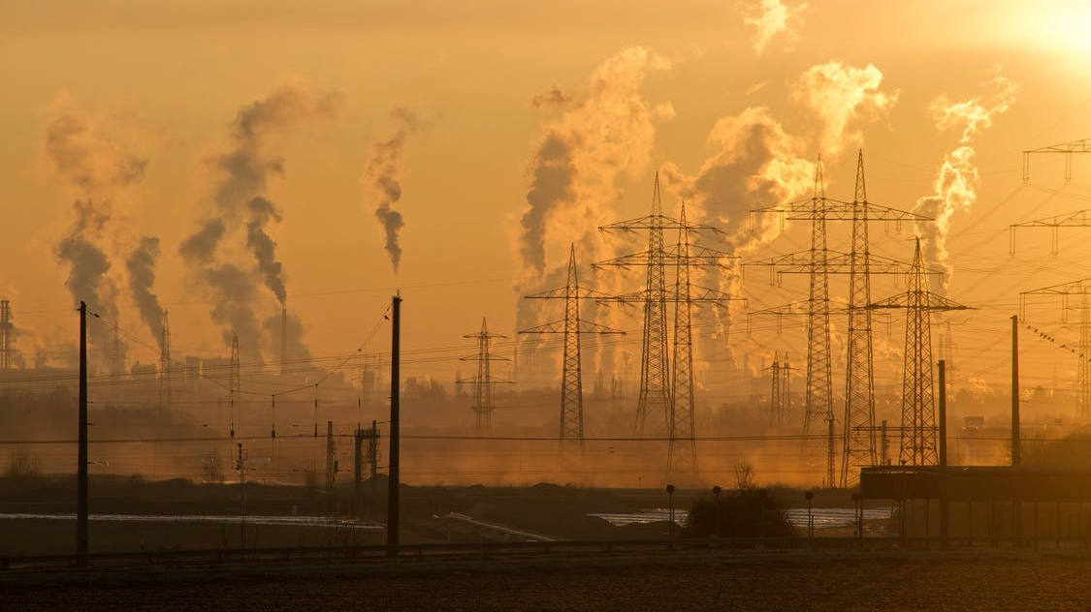
Environmental Impact of Bionanotechnology

Slide 39

Reducing Climate Change
Nanotechnological products, processes and applications are expected to contribute significantly to environmental and climate protection by saving raw materials, energy and water as well as by reducing greenhouse gases and hazardous wastes.
Using nanomaterials therefore promises certain environmental benefits and sustainability effects.

Slide 40
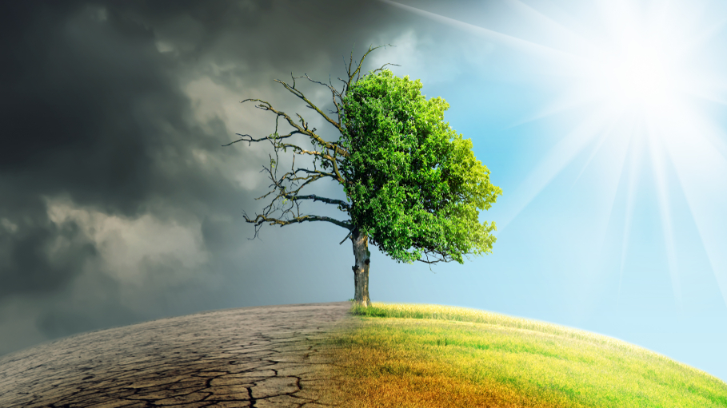
Nanotechnology's environmental impact can be split into two aspects: the potential for nanotechnological innovations to help improve the environment, and the possibly novel type of pollution that nanotechnological materials might cause if released into the environment

Slide 41
ACHEIVEMENTS

Slide 42
In Genetic Engineering
In genetic engineering programmes, it has
become possible to map the whole genome
of an organism to find out the function of the
genes, cut and transfer into another organism
Owing to the success achieved from gene
cloning, many products have been obtained
through genetically engineered cells, and
hopefully many can be produced during the
current decade.

Slide 43
Recombinant DNA technology has made it
easier to detect the genetic diseases and cure
before the birth of a child or suggest
accordingly. Gene bank and DNA clone bank
have been constructed to make available
different types of genes of its known function.
Thus, recombinant DNA technology has made it
possible to develop vaccines against viral and
malarial diseases, and growth hormones.

Slide 44
Agricultural Achievements

Slide 45
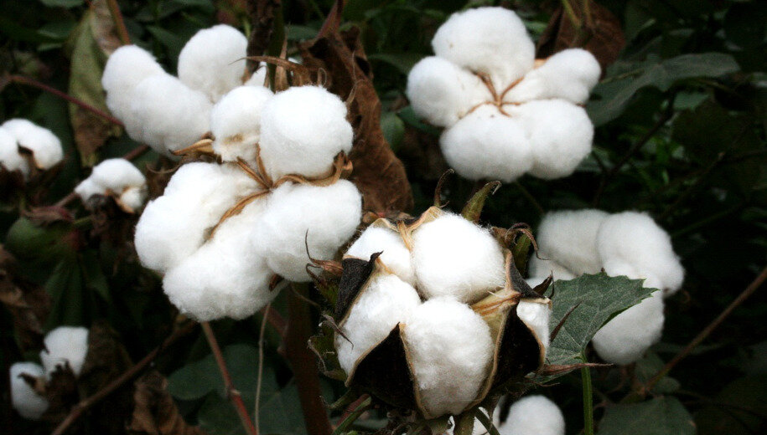
Herbicide Tolerant Crop Plants
Development of herbicide tolerant plants was the first major achievement in crop biotechnology employing the genetic transformation techniques. Transgenic plants resistant to a number of herbicides like Glyphosate, Imidazoline etc have been successfully developed.

Slide 46
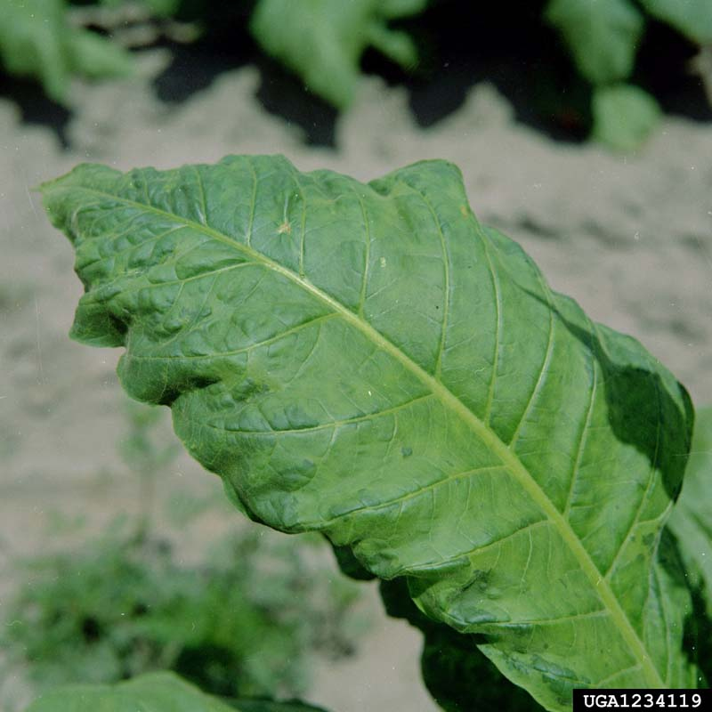
Engineering for Virus Resistance
Transgenic tobacco and tomato plants have been obtained using the coat protein (CP) approach, which are resistant to the Tobacco Mosaic Virus (TMV) and Tomato Mosaic Virus (ToMV), respectively.

Slide 47
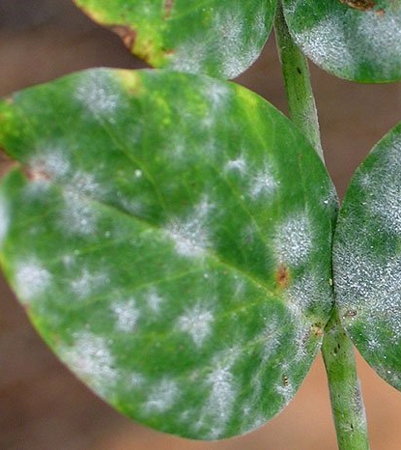
Resistance to Pathogenic Fungi and Bacteria
The genetic transformation techniques are also being used to produce transgenic crop plants showing resistance to various fungal and bacterial diseases. The losses in agriculture due to reduction in crop-yield can be prevented to some extent by cross protection of plants from pathogenic fungi or bacteria.

Slide 48
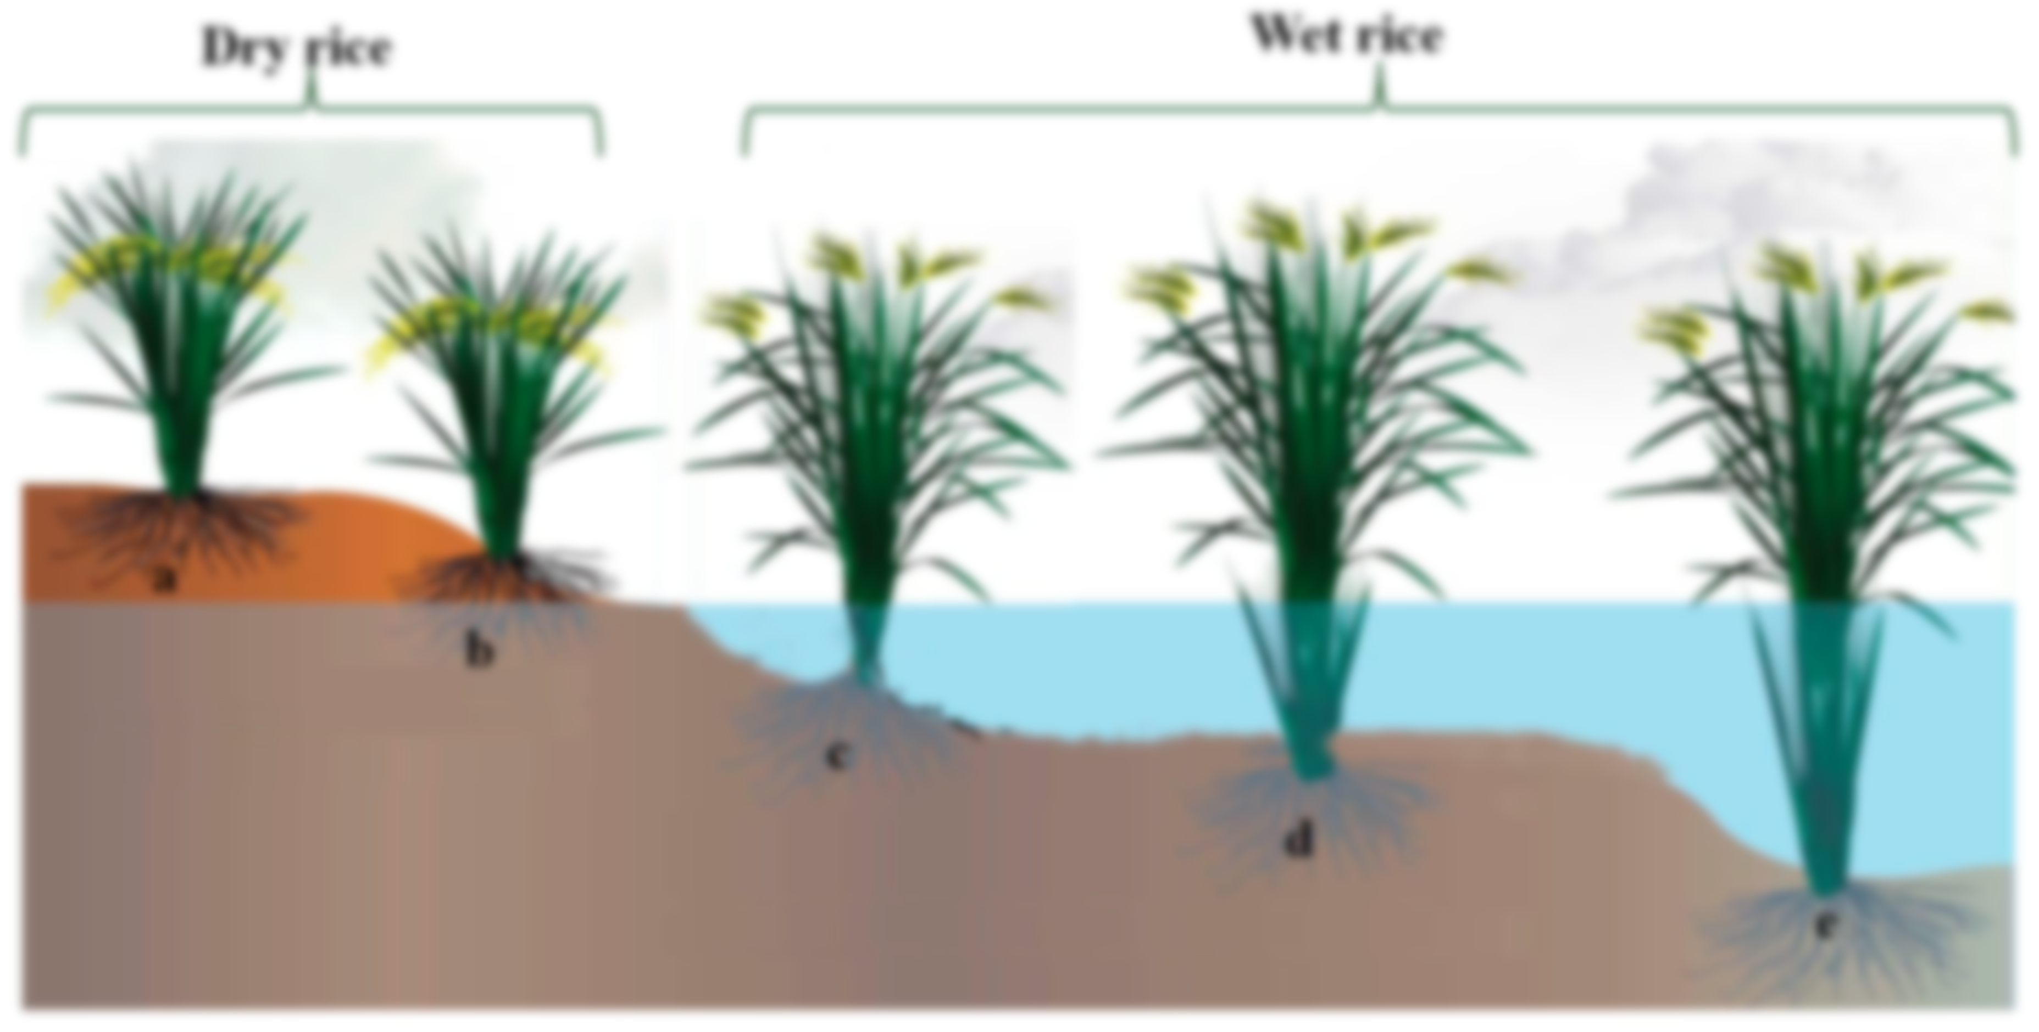
Engineering for Tolerance Against Abiotic Stresses
Tolerance to salinity, drought, chilling, etc. has been induced successfully in tobacco plants. Other major plant species in which the transgenic with improved drought resistance or other abiotic stress resistance has been achieved are rice and Arabidopsis.

Slide 49

The abiotic stresses like drought, flood, salinity, heat-shock etc. can also be resisted by the transgenic plants. All these abiotic stresses adversely affect the growth of plants and thus cause a major loss in agriculture.
To prevent such losses, genetic engineers have developed the stress tolerant plants of a number of crops. For this purpose, several plant genes have been cloned which encode for enzymes that are important for avoiding loss due to different stresses.

Slide 50
Improved Nitrogen Fixing Ability
Leguminous roots bear nitrogen-fixing nodules induced by some bacterial strains. Most important bacteria in this respect is Rhizobium. Some other bacterial strains like Klebsiella, Azotobacter and Cyanobacteria (Blue Green Algae) like Anabaena also fix nitrogen. The nitrogen fixing ability of these microbes is due to the presence of a cluster of genes called as nif-genes.

Slide 51
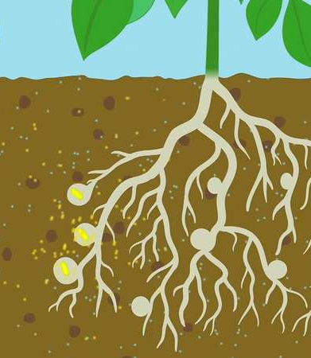
It is believed that if these nif-genes can be cloned in crop plants, the need to use fertilizers for enriching soil with nitrogen can be eliminated.
Efforts are being made in this direction to transfer nif-genes cluster from bacterial or cyanobacterial strains to plants. So far, success has been achieved in improvement of sugarcane and wheat, while research is being carried on for other plant species.

Slide 52
06
PERSPECTIVE, NEW POSSIBLITIES AND ETHICS
Lets see how small the nano scale really is

Slide 53
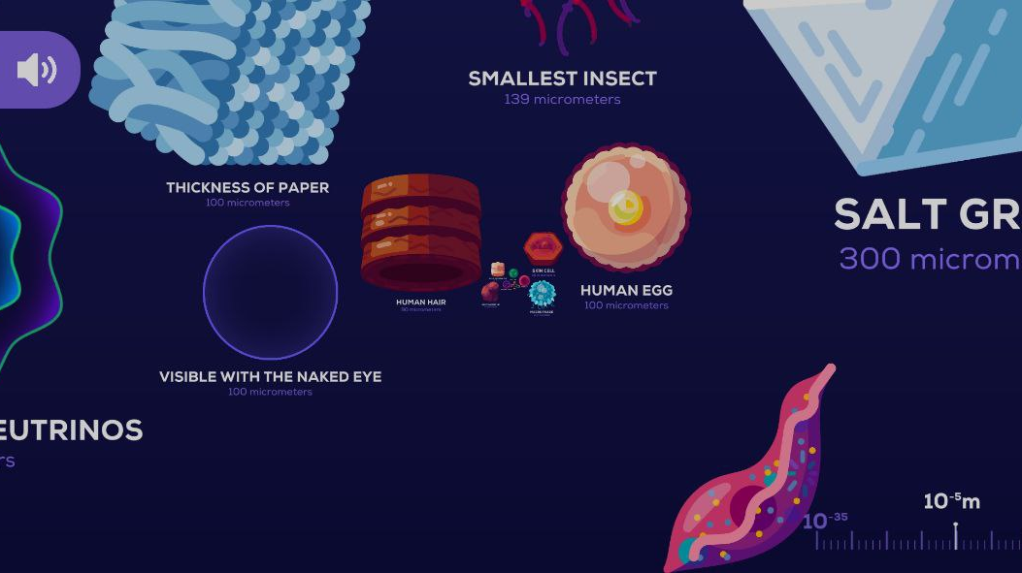

Slide 54
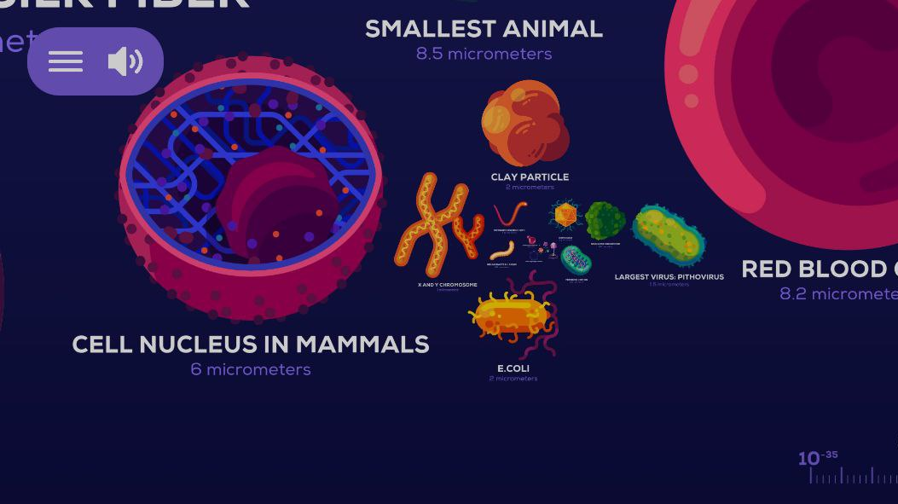

Slide 55
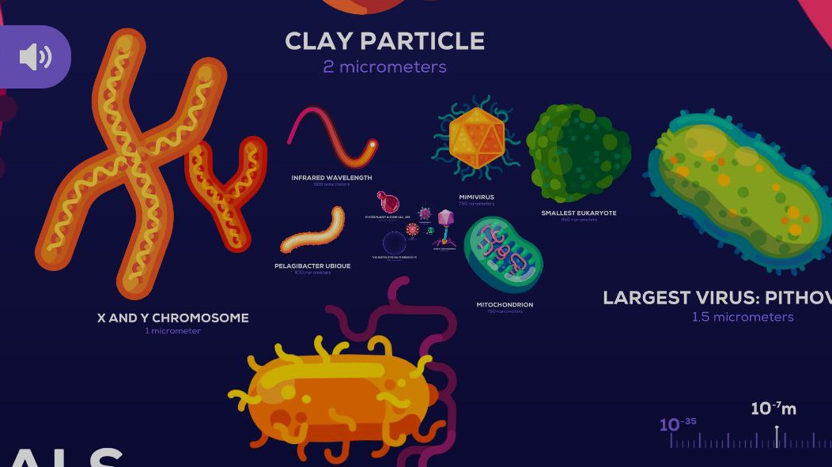

Slide 56
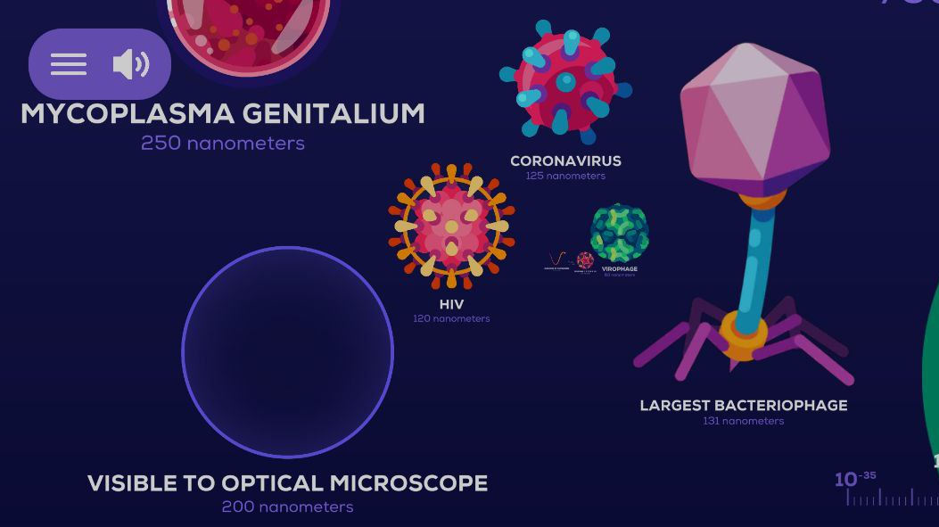

Slide 57
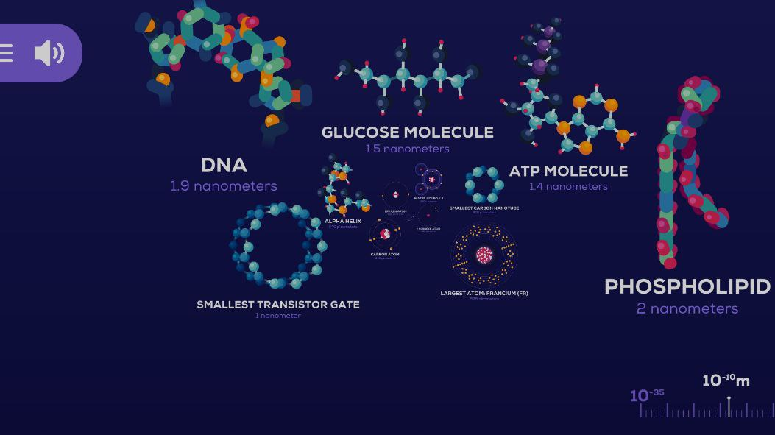

Slide 58
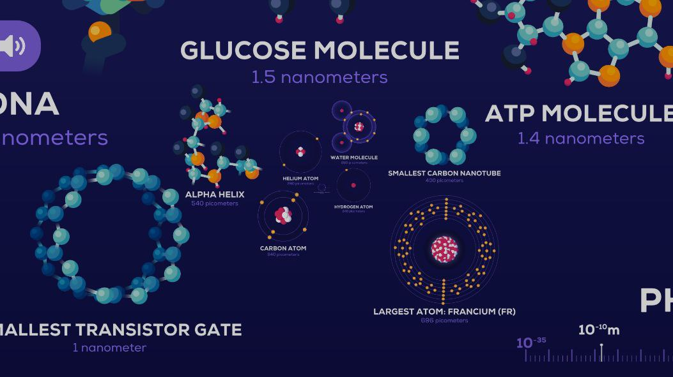

Slide 59

ETHICS

Slide 60
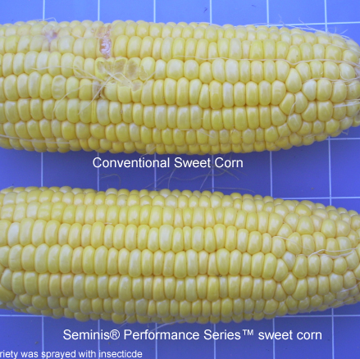
Genetically Modified Foods
A genetically modified organism (GMO) is an organism that has foreign DNA inserted into its genome using genetic engineering
Genetically modified plants were first introduced in US in 1996

Slide 61
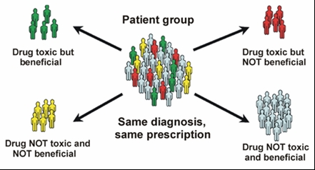
Personalized Medicine
Medicine that is prescribed based on your genetic information.
Eliminates the one-size fits all view of medicine.

Slide 62

Genetic Selectivity
Parents can screen embryos to determine the genetic properties of their future children. Uses of the technology includes
Curing or treating existing genetic defects in children
Obtaining children that have specific desired characteristics
Notes:
Nanoscale Science Connection-Analyzing DNA. See the Genetically Modified Foods slides on DNA and nanoscale connection.
A parent’s ability to screen embryos to produce children with desired characteristics is often dramatized on television as a great idea. Especially if the child is conceived to cure or treat a sick sibling. Genetic selectivity is a ethical concern since it lowers genetic variability in the population and sometimes the motives are questionable. Discuss with your students the consequences and benefits of having of a child with predetermined characteristics. Have your students examine this issue from the prospective of the parent and from the child that will be born to “help” their sibling.
At Inova Translational Medicine Institute in Falls Church, Va., researchers are mapping the genomes of newborns, along with their parents and other relatives for comparison. The long-term goal of the privately funded study is to uncover genetic patterns that predict complex health problems, from prematurity to developmental disorders. Others are concerned that this will lead to parents having genome sequencing to obtain “designer babies.”
If time permits, have your students read My Sister’s Keeper by Jodi Picoult which examines this issue.

Slide 63

Public Awareness
Some people do know the impact of many of the additives and chemicals that they come in contact with each day.
Notes:
Picture: MS clipart
Nanoscale Science Connection: Public awareness. In many cases the public is unaware or uneducated about the chemicals and substances that they are exposed to, often without their knowledge. Public awareness and perception of science is an ethical concern that may advance or halt scientific progress.
In 2013, California residents voted to reject Proposition 37, which would require companies to label genetically modified organisms. As stated on the slide about genetically modified foods, many people are unaware of the amount of genetically modified plants that they consume. Corn and soy are the most common GMOs and they are used in almost all processed food from sodas to frozen entrees. Public awareness and understanding is important in scientific progress. Other concerns are the use of artificial flavors, synthetic hormones, antibiotics, high fructose corn syrup, and preservatives and their impact on health. Educating the public and explaining the advantages and disadvantages of scientific research will help to prevent backlash from misunderstandings.
Discussion: Should the public be made aware of GMO products in their food? How should the food be labeled? Would the labels be effective and change consumer habits? Should food manufactures have a GMO and non-GMO (organic) selection of all their products (some companies already do). While chemicals are already labeled on food packages, do you think most people have an understanding of their impact on health?

Slide 64
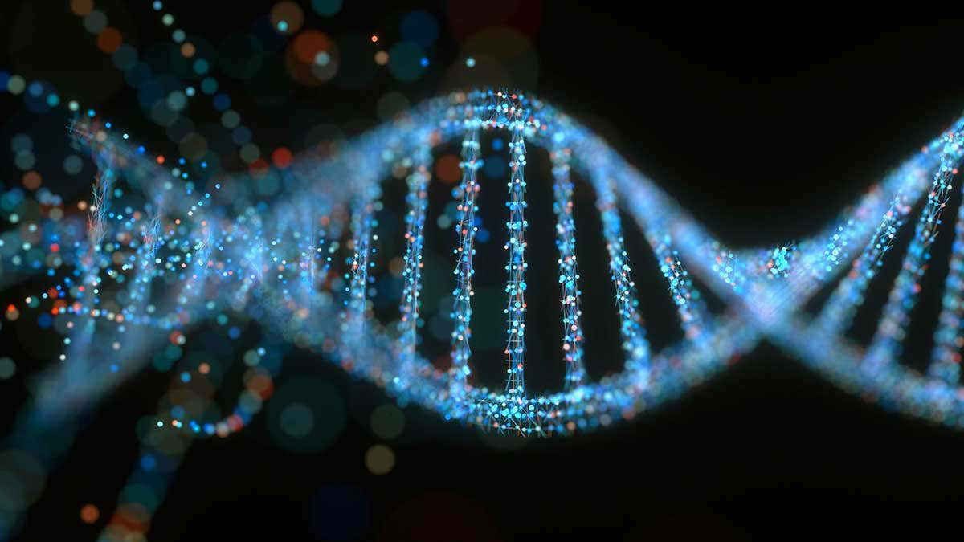
Thank You!

Slide 65
Group Members
04. Nandana Nambiar
14. Siddharth Aditya
24. Zameer Siddique
34. Vedant Singh
44. Devanshu Surana
54. Krishnaraj Thadesar
64. Pushkar Vaswad
74. Shubham Yadav

Slide 66
Credits and Resources
Some Slides backgrounds are templates taken from slidesgo, Illustrations from flaticon and images from freepic. More images from Google images and several other websites.
Books Referred for Material:
Introduction to Bionanotechnology by Young-Chul Lee, Ju-Young Moon (z-lib.org)
Emerging Conceptual, Ethical and Policy Issues in Bionanotechnology (Philosophy and Medicine) by Fabrice Jotterand (z-lib.org)
Bionanotechnology Principles and Applications by Anil Kumar Anal (z-lib.org)
Bionanotechnology Lessons from Nature by David S. Goodsell (z-lib.org)

